Slide 1

Machine Learning and Imaging
Methods
Erik Dam and Raghavendra Selvan Data Science Lab
Faculty of SCIENCE

Slide 2
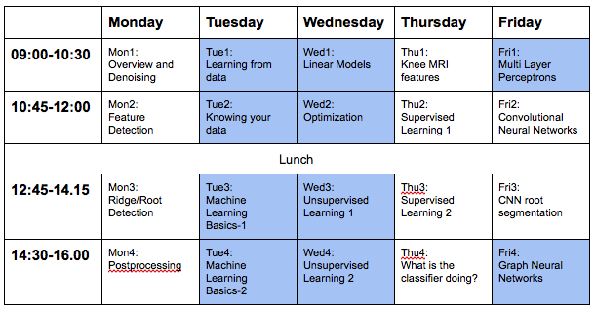
Program

Slide 3
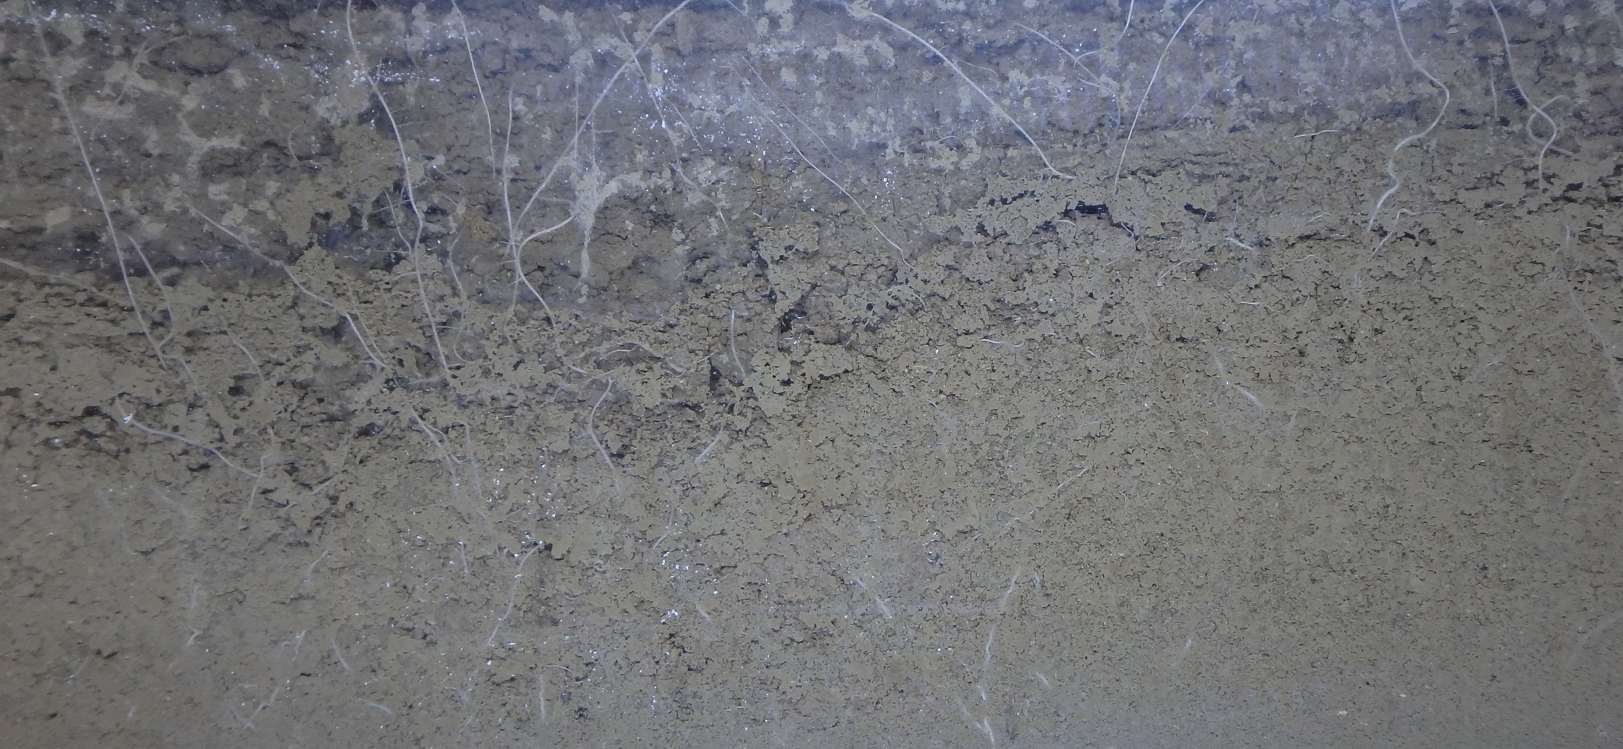
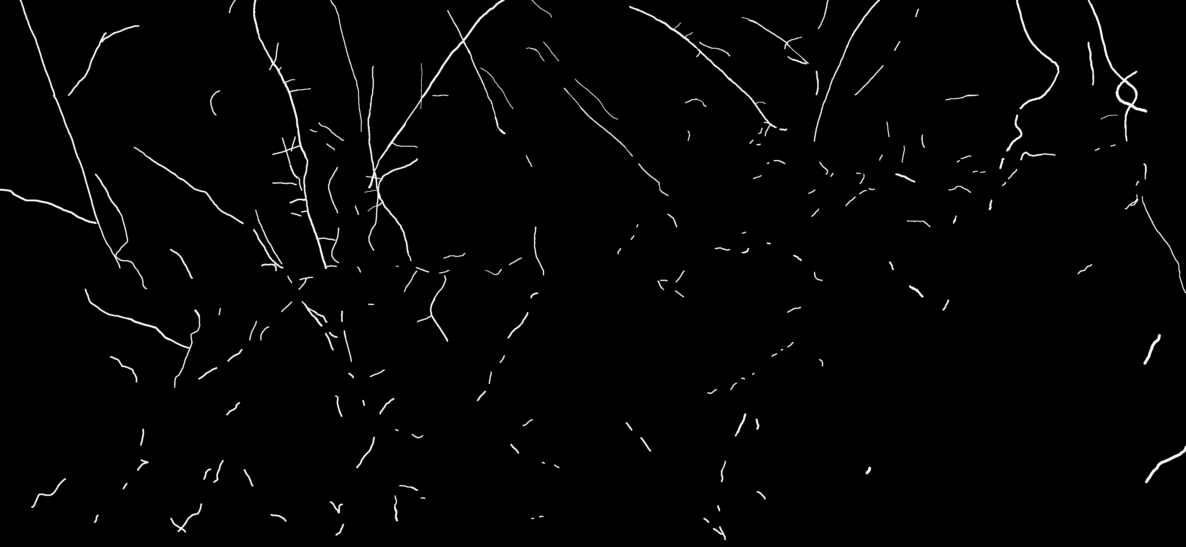
Friday - CNN
How many roots are there in this picture (and the x00.000 other pictures like this):
Courtesy of Camilla Ruø Rasmussen, Simon Fiil Svane, Abraham Smith, et al, PLEN, UCPH

Slide 4
Convolutional Neural Network
Raghav just introduced Multi-Layer Perceptron (MLP):
Simple linear “neurons”, or just filters
Non-linear layers (e.g. activation functions)
Multiple layers allow complex models
Effective optimization (back-propagation)
Convolutional Neural Networks:
Same principle as MLP
Filters are limited and have a concept of proximity
Pooling layers: Non-linear, can add spatial invariance

Slide 5
Filters
MLP had fully connected, linear combinations of features. Basically a linear filter with global support.
CNN has convolution filters:
Limited support (e.g. 5 x 5 filter) in each layer
Larger support via multiple layers
Instead of designed filters (like the edge/blob/ridge filters we used Monday), filters are optimized for the task at hand
By using many filters in each layer, multiple features can be combined

Slide 6
Pooling
Pooling down-samples the data by replacing a small region/window (e.g. 2x2 pixels) with a single value.
Mean pooling:
Same as a uniform convolution filter
Max pooling:
Think “feature detector”. Picks maximal response somewhere in the window.
Since output is invariant to position (in window!), this adds some degree of spatial invariance

Slide 7
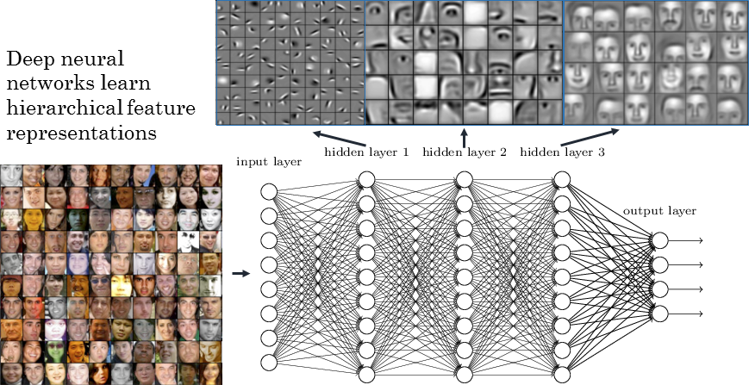
CNN transparency: Face Recognition Idealized Example
https://towardsdatascience.com/coding-deep-learning-for-beginners-start-a84da8cb5044

Slide 8
Some Central Concepts
Batch training
Batch normalization
Drop-out
Data augmentation
Filter initialization
Pre-training
Optimization
Skip connections (concatenation)

Slide 9
Digit Classification
Off to Visual Studio Code …

Slide 10
Root Segmentation
Off to Visual Studio Code …

Slide 11
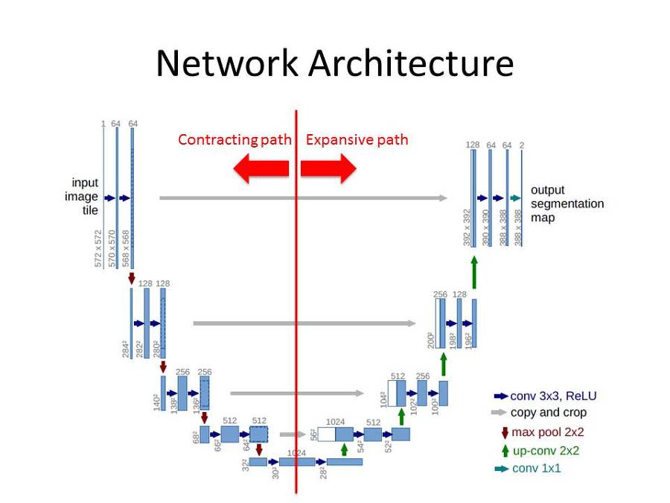
Unet
State-of-the-art in segmentation:

Slide 12
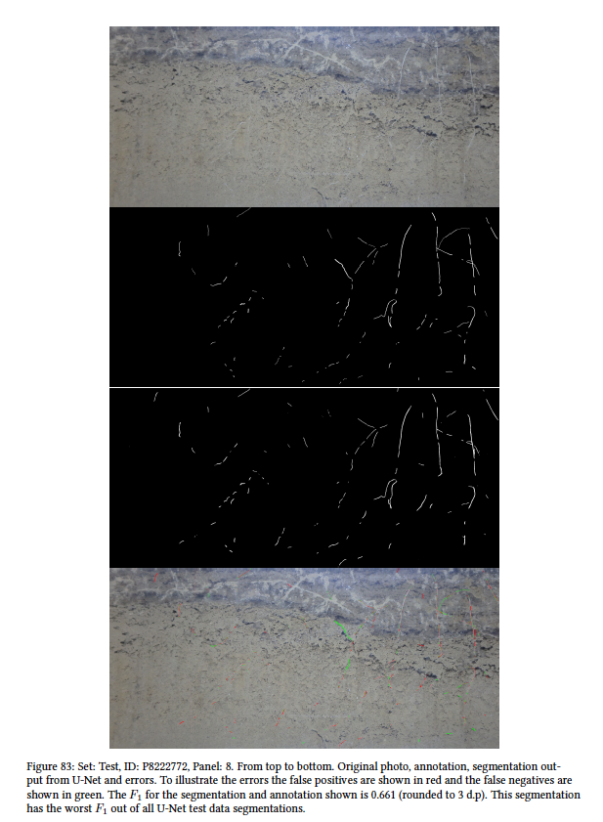
Back to the Roots
Abraham’s MSc thesis:
https://arxiv.org/abs/1902.11050
The worst segmentation example from his thesis is shown to the right

